Slide 1



Slide 3
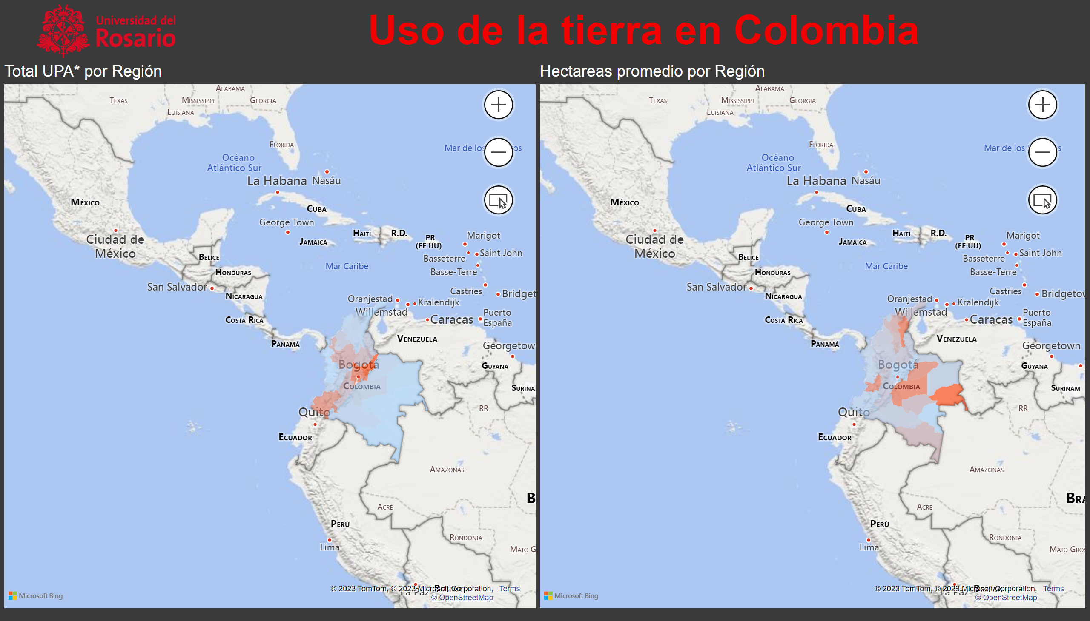
Mapas - Uso del suelo
Notes:
filledMap
No alt text provided
image
No alt text provided
filledMap
No alt text provided
textbox
No alt text provided

Slide 4
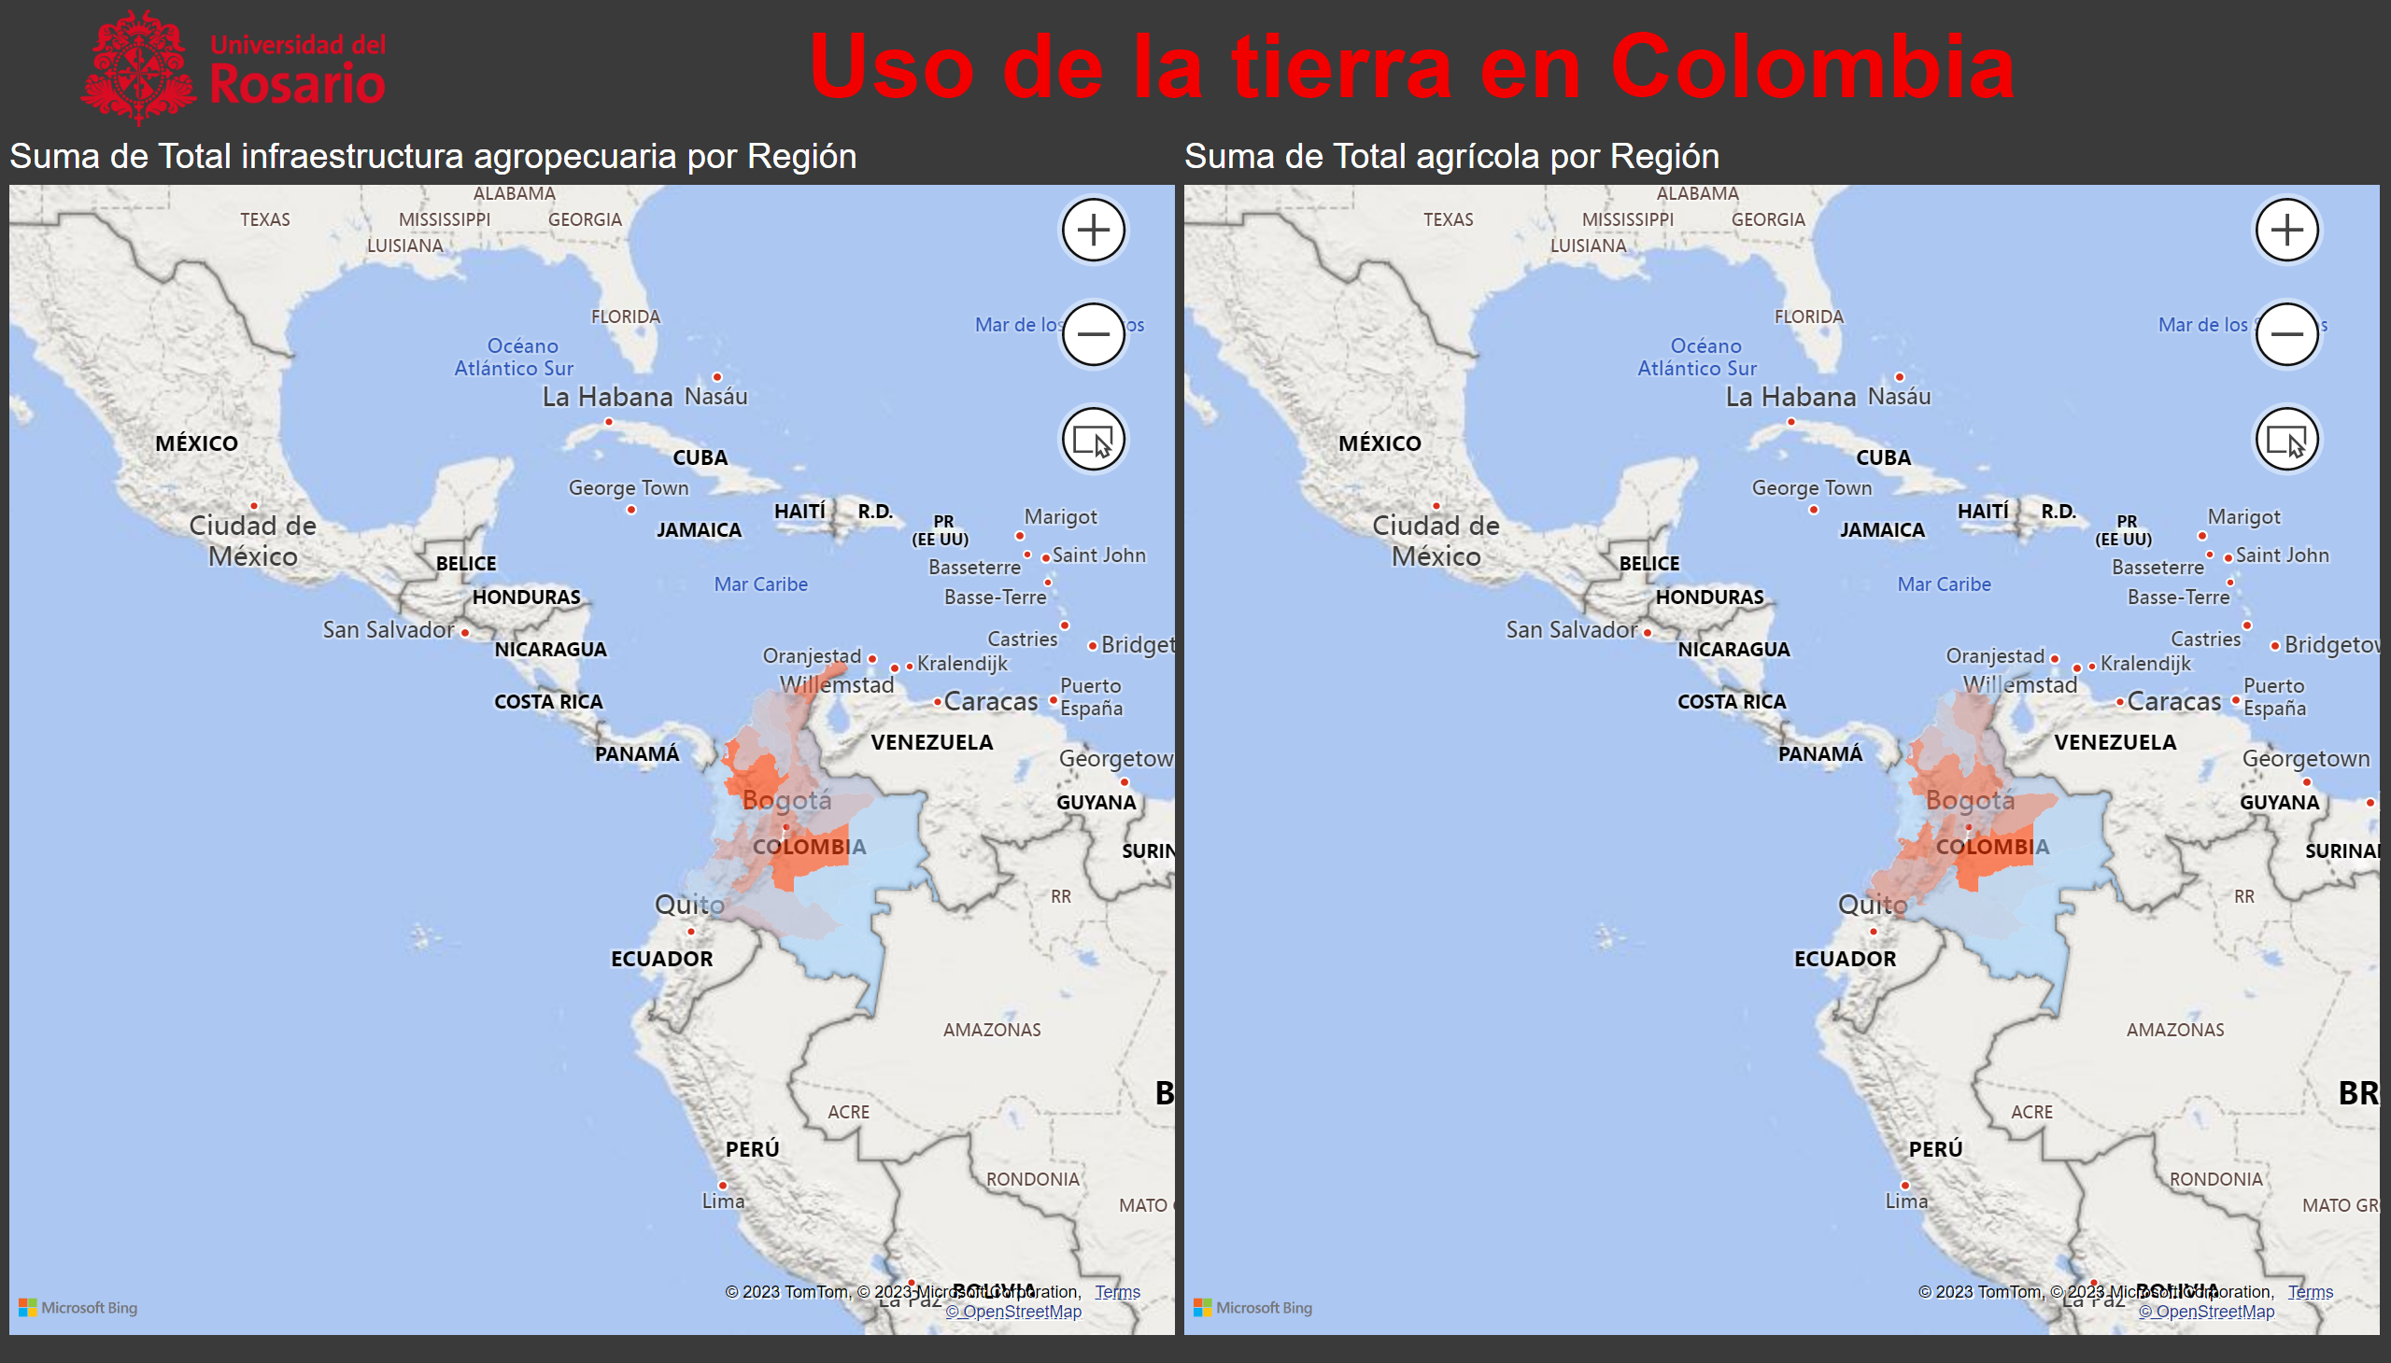
Uso del suelo -2
Notes:
filledMap
No alt text provided
image
No alt text provided
filledMap
No alt text provided
textbox
No alt text provided

Slide 5
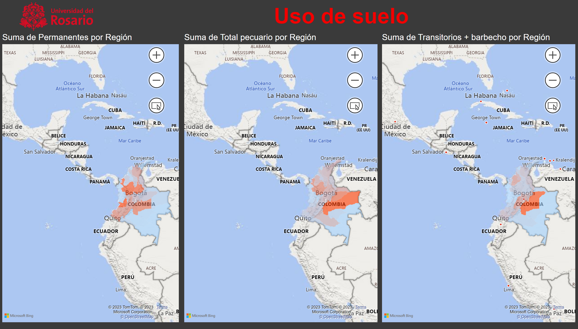
Uso del suelo 3
Notes:
filledMap
No alt text provided
image
No alt text provided
filledMap
No alt text provided
textbox
No alt text provided
filledMap
No alt text provided

Slide 6
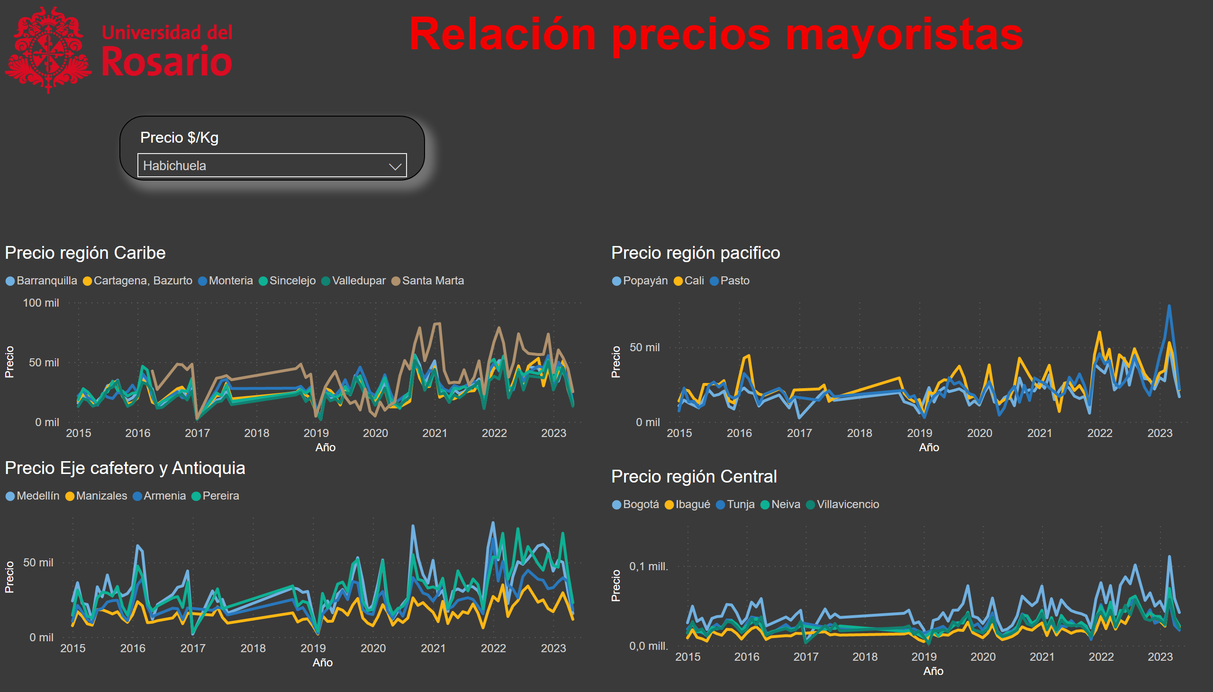
Relación
Notes:
image
No alt text provided
textbox
No alt text provided
Precio región Caribe
No alt text provided
slicer
No alt text provided
Precio región pacifico
No alt text provided
Precio Eje cafetero y Antioquia
No alt text provided
Precio región Central
No alt text provided

Slide 7
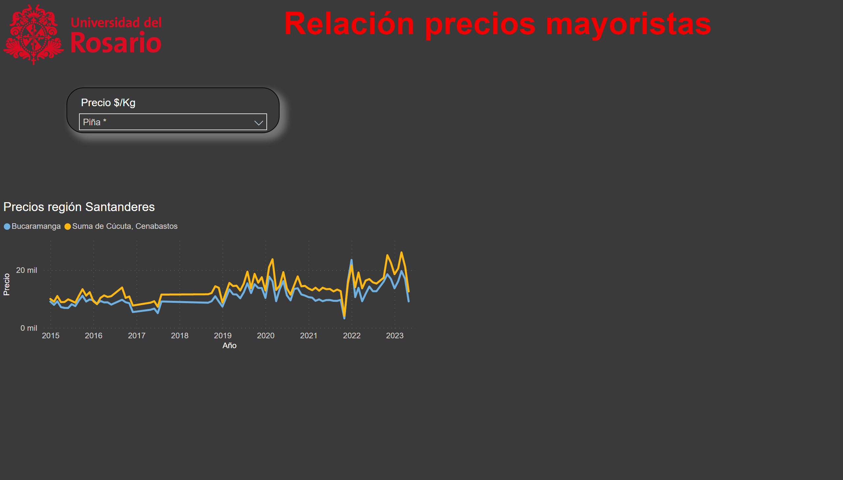
Relación 2
Notes:
image
No alt text provided
textbox
No alt text provided
slicer
No alt text provided
Precios región Santanderes
No alt text provided

